Slide 1
Type of Data

Slide 2
Typical Data Science Cycle
Data Collection
Business Insights & Understanding
Data Understanding
Model Building & Evaluation
Data Pre-Processing

Slide 3
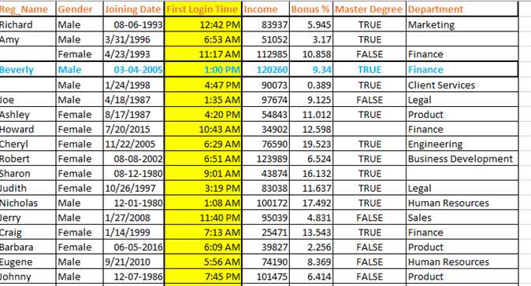
Data
Variable/Attribute/Feature
Data Point/Record/Row/Observation
Column

Slide 4
Types of Data
Qualitative Data (Categorical) are nonnumeric in nature and can't be measured. Examples are gender, religion, and place of birth.
Quantitative Data (Numerical) are numerical in nature and can be measured. Examples are balance in your savings bank account, and number of members in your family.
Qualitative data can also be referred as ‘Dimensions’
Quantitative data can also be referred as ‘Measures’

Slide 5
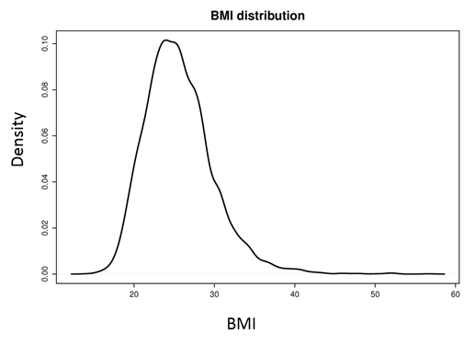
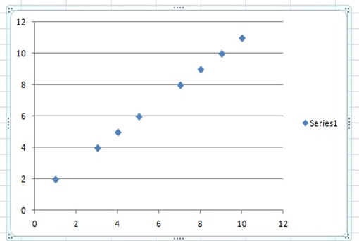
Types of Quantitative Data
Discrete type can take only certain values, and there are discontinuities between values, such as the number of rooms in a hotel, which cannot be in fraction.
Continuous type can take any value within a specific interval, such as the production quantity of a particular type of paper (measured in kilograms).
Discrete
Continuous

Slide 6
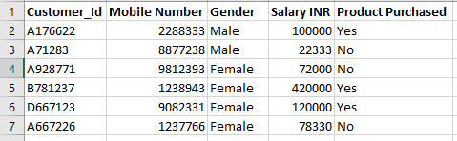
Data Measurements
Variable : A quantity whose value changes across the population and can be measured.
To perform statistical analysis of data, it is important to first understand what should be measured using these variables. The level of measurement of a variable decides the statistical test type to be used.

Slide 7
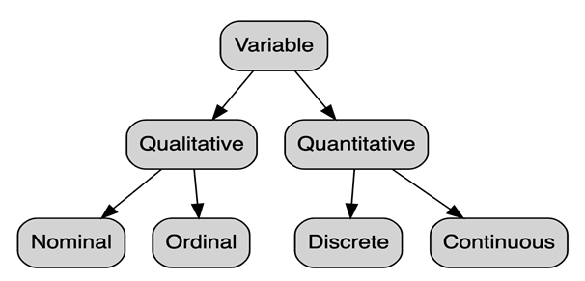

Data Measurements
There are different levels of measurement using data can be classified into
qualitative and quantitative data measurements.
•Nominal
•Ordinal
•Interval
•Ratio
Information
Content
Increases

Slide 8
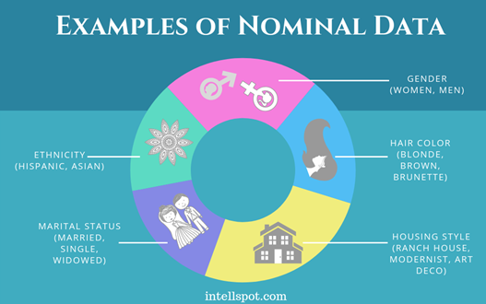
Types of Data Measurements
Nominal Data: The weakest data measurement also called the categorical variable scale. Numbers are used to naming, label an item or characteristic. Categorization is the main purpose of this measurement.
There is usually no intrinsic ordering or numerical meaning of nominal data .
Such as Male/Female do not have any ranking preference.
Examples:
1. Various type of demography
2. savings bank account numbers
3. Customer IDs

Slide 9
Types of Data Measurements
Ordinal or Rank Data: These are used to rank.
Ordinal data can also be verbalized on a continuum like excellent, good, fair and poor.
In ordinal data, distance between objects cannot be measured.
Simple Arithmetic operations are not feasible on Nominal/Ordinal data.

Slide 10
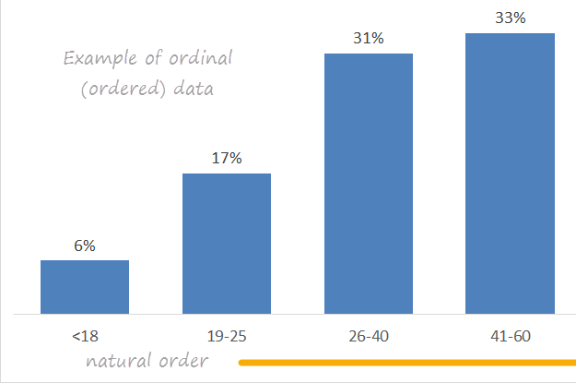
Types of Data Measurements
Ordinal or Rank Data: Numbers are used to rank.
NOTE: very hot, hot, cold, very cold, warm are all nominal data when considered individually. But when placed on a scale and arranged in a given order (very hot, hot, warm, cold, very cold), they are regarded as ordinal data

Slide 11
Types of Data Measurements
Interval Data: If you have data with ordinal properties and can also measure the distance between objects, you have an interval measurement.
It always appears in the form of numbers or numerical values where the distance between the two points is standardized and equal. Interval data is measured on an interval scale.
Interval data cannot be multiplied or divided, however, it can be added or subtracted (e.g. find center of point 3 and point 5).
Example
The difference between 100 degrees Fahrenheit and 90 degrees Fahrenheit is the same as 60 degrees Fahrenheit and 70 degrees Fahrenheit
the difference between 17:10 and 17:20 is the same as 15:20 and 15:30 in 12 hour clock
Calendar dates

Slide 12
Types of Data Measurements
Interval Data
The lack of absolute point zero makes comparisons of direct magnitudes impossible (i.e. it does not have absence of property). For example, Object A is twice as large as Object B is not a possibility in interval data
it can also be understood as a * old_value + b where a and b are constants in a data transformation process
Interval data are often used for statistical research, school grading, scientific studies and probability
there are a few analysis methods such as descriptive statistics, correlation regression analysis which is extensively for analyzing interval data.

Slide 13
Types of Data Measurements
Ratio Data: It is the highest level of measurement and allows you to perform all basic arithmetic operations, including division (ratio) and multiplication.
Data measured on a ratio scale have a fixed zero point (absence of property). Examples include business data, such as cost, revenue, market share and profit.
Because of the existence of true zero value, the ratio scale doesn’t have negative values.
Ratio scale accommodates the characteristic of three other variable measurement scales, i.e. labeling the variables, the significance of the order of variables, and a calculable difference between variables (which are usually equidistant)

Slide 14
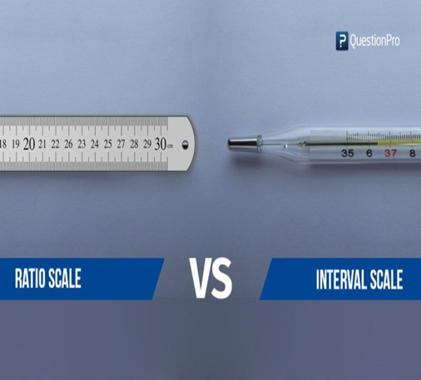
Types of Data Measurements
Offers: | Nominal | Ordinal | Interval | Ratio
The sequence of variables is established | – | Yes | Yes | Yes
Mode | Yes | Yes | Yes | Yes
Median | – | Yes | Yes | Yes
Mean | – | – | Yes | Yes
Difference between variables can be evaluated | – | – | Yes | Yes
Addition and Subtraction of variables | – | – | Yes | Yes
Multiplication and Division of variables | – | – | – | Yes
Absolute zero | – | – | – | Yes

Slide 15
Sampling

Slide 16
Sampling
Let’s say a company wants to study customer preference for some features of mobile phone to design
a new product. How to go for it?
1) It could ask all people in the state what they like about phone and if they would prefer their new product?
2) Study of population sample and draw inference about complete population
Expertise of sampling process mostly required into market research.

Slide 17
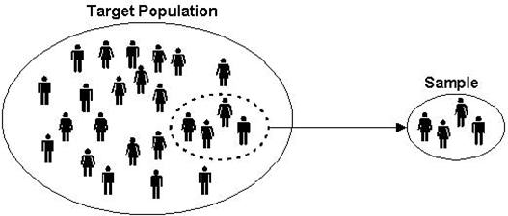
Sampling
Sampling is a method of selecting units of analysis such as households, people, consumers, companies etc from a population (universe) of interest to a manager.
Instead of taking complete population into study (census method) ,
we do sampling procedure to save time and money.
A statistic is an estimate based on sample data to draw inferences about a population characteristic of interest called the parameter

Slide 18
Sampling
Types of Sampling :
Probabilistic Sampling : A probability sampling is a method of sampling that ensures that every unit in the population has a known non-zero chance of being selected
Non-Probabilistic Sampling : The selection of the sample units does not ensure a known chance to the units being selected.

Slide 19
Sampling
Parameters | Non Probabilistic
Convenience | More compared to probabilistic sampling
Time | Less compared to probabilistic sampling
Cost | Less compared to probabilistic sampling
Accuracy | lacks accuracy in view of the selection bias.
generalizability in implementation | It is unable to generalize results from sample of population
It is mandatory in inferential statistics to use only probability sampling for valid conclusions.
Non-probability sampling is suitable for pilot studies and exploratory research.

Slide 20
Sampling
Types of sampling
Probabilistic sampling
Non-probabilistic sampling
Simple
Random
Sampling
Stratified
Random
Sampling
Convenience
Sampling
Expert Opinion
Systematic
Sampling
Cluster Sampling
Quota Sampling

Slide 21
Probabilistic Sampling
Some Key Terms in Sampling
N = Number of units in the Population
n = Number of units in the Sample (Sample Size)
f = n/N = Sampling fraction

Slide 22
Probabilistic Sampling
Simple Random Sampling
It is the foundation of Probability Sampling.
In Probability Sampling every unit in the population has the same chance of being selected (assuming selection is done without replacement)
If you have to select n units out of N units, every possible selection of n units must have the same probability

Slide 23
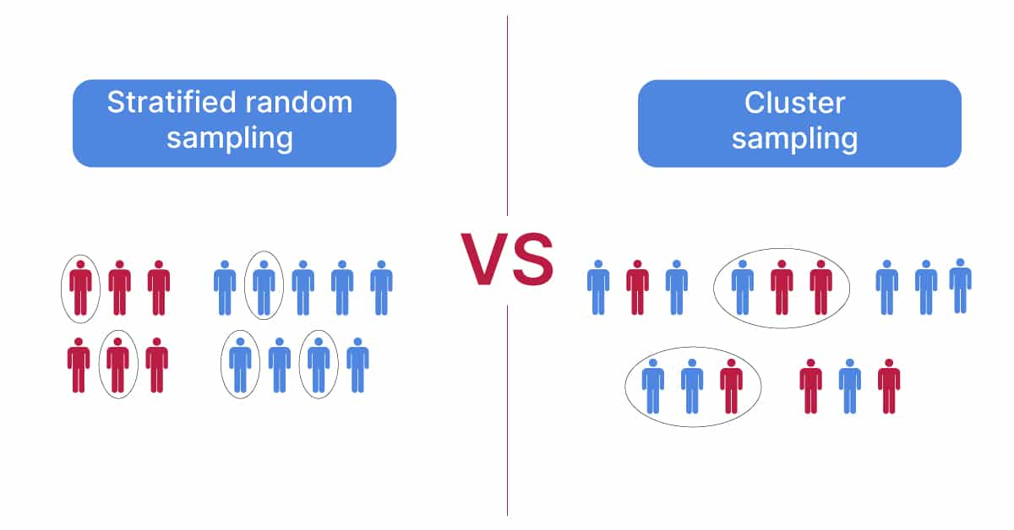
Probabilistic Sampling
Stratified Random Sampling :Split the data into several partitions; then draw random samples from each partition
Process:
It involves dividing the population into a number of groups such a
manner that the units within a group are homogenous and the units
between the groups are heterogeneous.
These groups are called strata.
Having divided the population into a number of group,
now select a simple random sample of appropriate size from each group.
E.g. Take equal proportion of each category in machine learning classification.

Slide 24
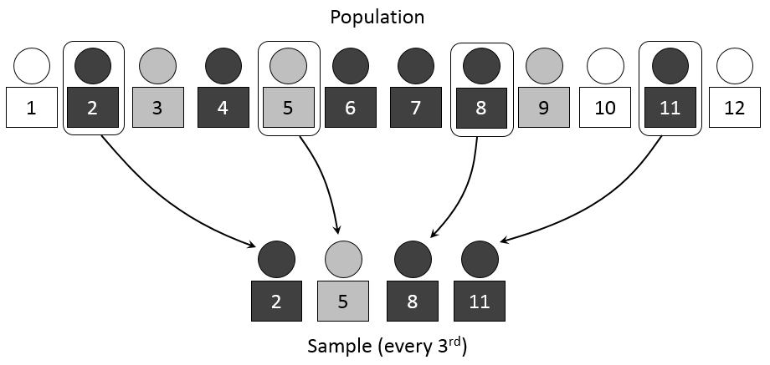
Probabilistic Sampling
Systematic Sampling
In systematic random sampling, the units are drawn from the population
at regular intervals clearly defined.
It is one of the easiest procedures to follow.
The steps involved in constructing a systematic sampling scheme:
Compute K =(N/n) and take the integer value. K is called the
sampling interval
Select a random number between 1 and K
Starting with this number select every Kth number until all the n units are selected

Slide 25
Probabilistic Sampling
Cluster Sampling
Divide the population into a number of clusters based on geographic boundaries
Select a random sample of clusters from this population of clusters
Measure all units within the randomly chosen clusters
Here units within groups are heterogeneous but in stratified sampling units within
strata were homogenous
If we do further sampling within each cluster by adopting a simple random sampling or stratified random sampling, the procedure becomes a multi-stage sampling.

Slide 26
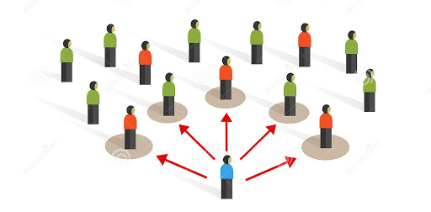
Non -Probabilistic Sampling
Convenience Sampling
Process of convenience sampling:
In consumer panel studies you may use clients who are available to you as your respondents for giving their opinion on products and services.
In many research projects, you simply look for volunteers to participate.
results are very very unreliable using convenience sampling!

Slide 27
Non -Probabilistic Sampling
Expert Opinion Sampling
It involves gathering a set of people who have the knowledge and expertise in certain key areas that are crucial to decision making.
In qualitative methods of demand projection for a new product, you use the expert opinion method to arrive at a reasonable forecast.
The advantage of this sampling is that it acts as a support mechanism for some of your decisions in situations where virtually no data are available.
The major disadvantage is that even the experts can have prejudices, likes, and dislikes that might distort the results.

Slide 28
Non -Probabilistic Sampling
Quota sampling
In simple terms, quota sampling is stratified random sampling without probability principle being applied to the selection of the sample units.
Suppose in an opinion study, you want both men and women to participate. You know that in the population category of interest, 65% are men and 35 % are women. If your sample size is fixed at 200, you will have a quota of 130 men and 70 women.
It doesn’t matter how you get them as long as you have met the quota.
Drawing any possible conclusions from a quota sampling will be highly tentative. None of the statistical inference techniques should be applied when you have followed quota sampling or for that matter any non-probability sampling procedure

